Slide 1
ASSIGNMENT: FUZZY LOGIC
ANINDYA S. DAS(1811MC02)

Slide 2
PROBLEM STATEMENT
“Fuzzy controller for inverted pendulum”
Fuzzy Input variable: Angular departure(θ)
Terms: Negative Medium, Negative Small, Zero, Positive Small, Positive Medium
Fuzzy Input variable: Angular velocity(θ.)
Terms: Negative Medium, Negative Small, Zero, Positive Small, Positive Medium
Fuzzy Output variable: Current(i)
Terms: Negative Medium, Negative Small, Zero, Positive Small, Positive Medium

Slide 3
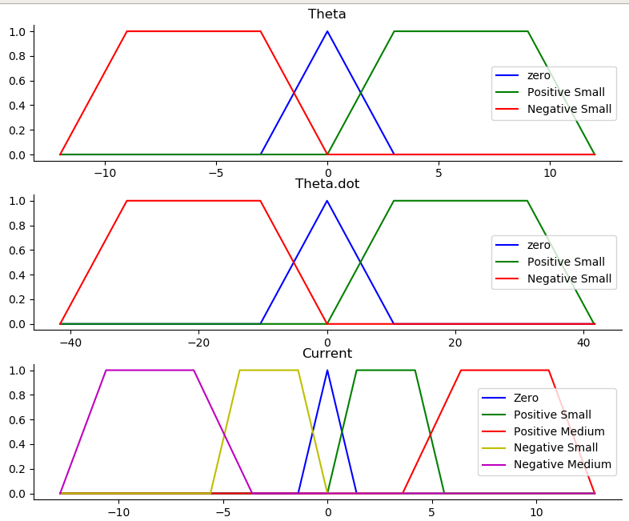
PROFILES OF ANGULAR DEPARTURE, ANGULAR VELOCITY AND CURRENT

Slide 4
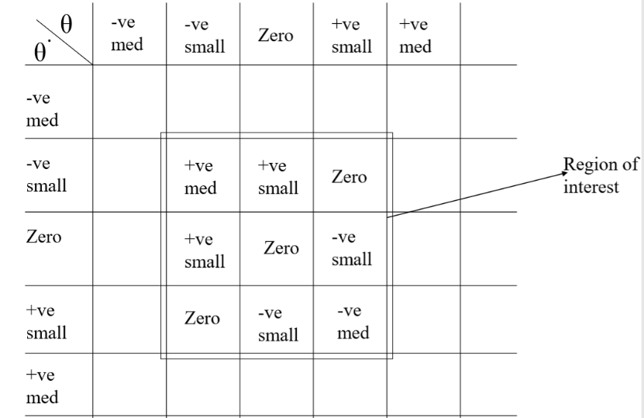
CONTROL MATRIX

Slide 5
FUZZY RULES
1.if θ == Zero and θ. == Zero then i = Zero.
2.if θ is Positive small and θ. = = Zero then i is Negative small.
3.if θ is Negative small and θ. = = Zero then i is small.
4.if θ = = Zero and θ. is Positive small then i is Negative small.
5. if θ = = Zero and θ. is Negative small then i is Positive small.

Slide 6
STEPS
a. Fuzzification of sensed values(θ and θ.).
b. Getting the values of μ(i) from control rules.
c. Defuzzification to obtain ONE i by the centroid method.

Slide 7
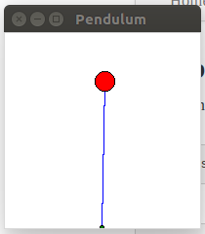
OUTPUT(GUI)

Slide 8
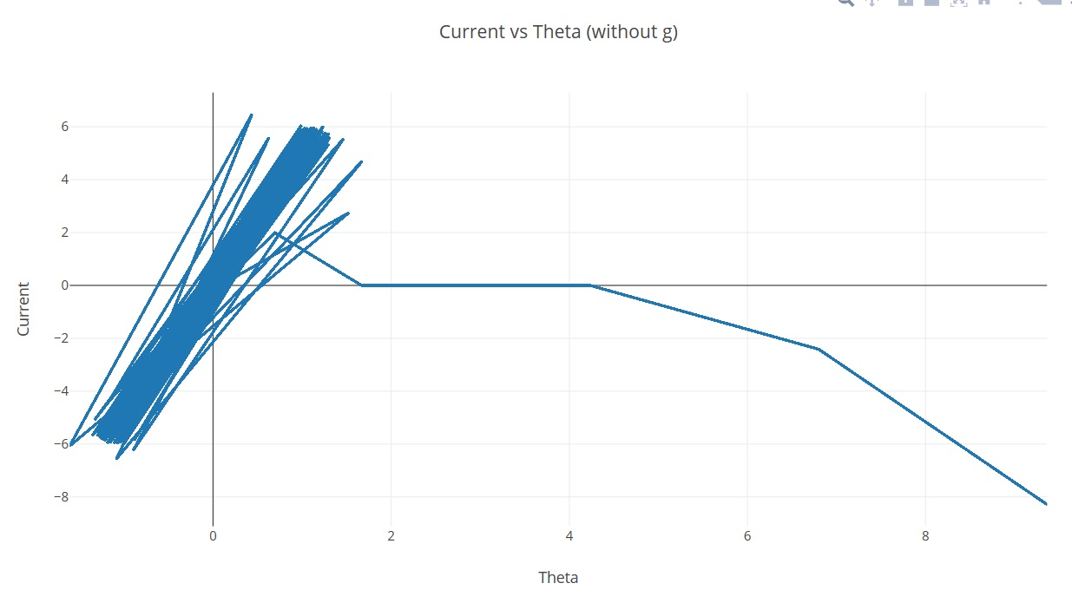
PLOTTING CURRENT VS THETA (without g)

Slide 9
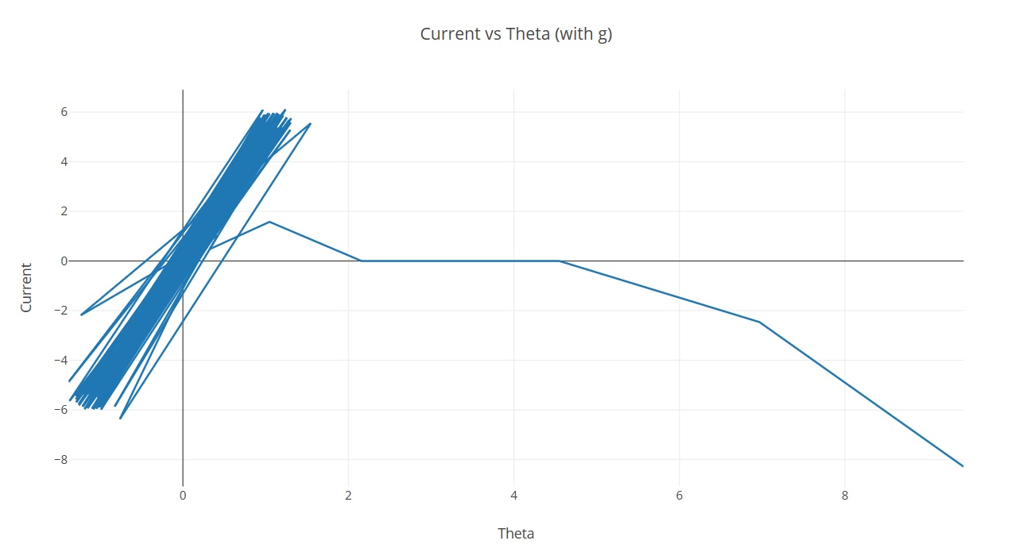
PLOTTING CURRENT VS THETA (with g)

